Slide 1
Vanna AI – Summary - Rohit Vishwakarma

Slide 2
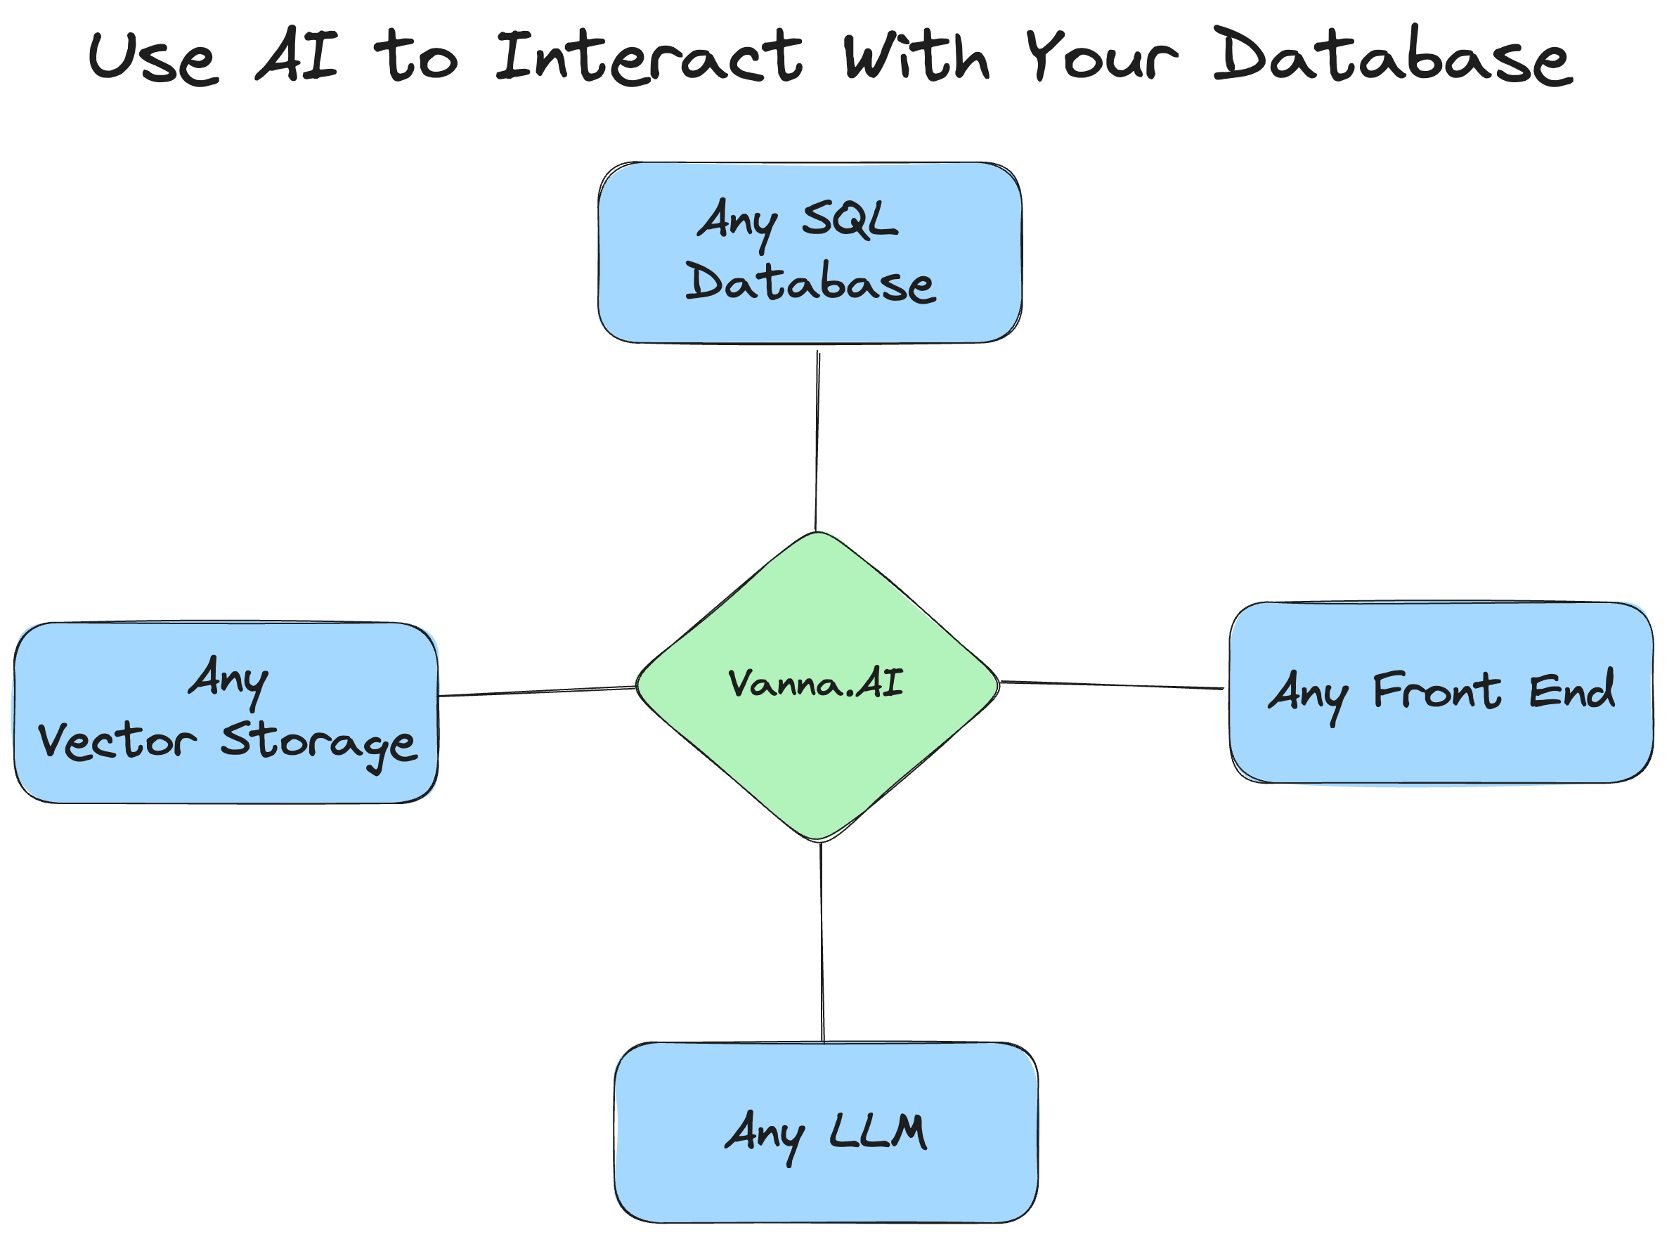
What is it?
An Open-source Natural language(RAG) to SQL Framework provided as a Python library.
It is NOT an LLM of its own.
Has in-built functionalities to:
train the bot using RAG on any data
Add/remove vector training data
Get SQL query, SQL result and the final answer in natural language
get follow-up questions, create and render analytical plot images and many more things.
Connect to frontends such as a Flask frontend.

Slide 3
Vanna AI Architecture
Vanna works in two easy steps - train a RAG model on your data, and then ask questions which will return SQL queries that can be set up to automatically run on your database.

Slide 4
Training
The primary determinant of the output accuracy of the system is the quality of the training data.
In Vanna AI, Training DOES NOT mean actual training. It just means providing User queries and their SQL statements as Vector Data which can be retrieved based on similarity match.
Vanna AI uses the following method to train data –
import vanna as vn
vn.train()
vn.train(ddl="CREATE TABLE my_table (id INT, name TEXT)")
vn.train(documentation="Our business defines XYZ as ABC")
vn.train(sql="SELECT col1, col2, col3 FROM my_table")
vn.train( question="What is the average age of our customers?", sql="SELECT AVG(age) FROM customers" ) – this is the most popular training method
Post training, we can also view the training data using –
vn.get_training_data()
Refer - https://vanna.ai/docs/train/

Slide 5

Ask
After training, a user can start asking questions using the following –
import vanna as vn
vn.ask()
Example - vn.ask("What are the top 10 customers by sales?")
Under the hood, vn.ask() runs these independent functions sequentially –
* Note that these can be independently called and used in our application without the need to call vn.ask()
For getting the final answer in Natural language, Vanna has vn.generate_summary() function
Refer - https://vanna.ai/docs/ask/

Slide 6
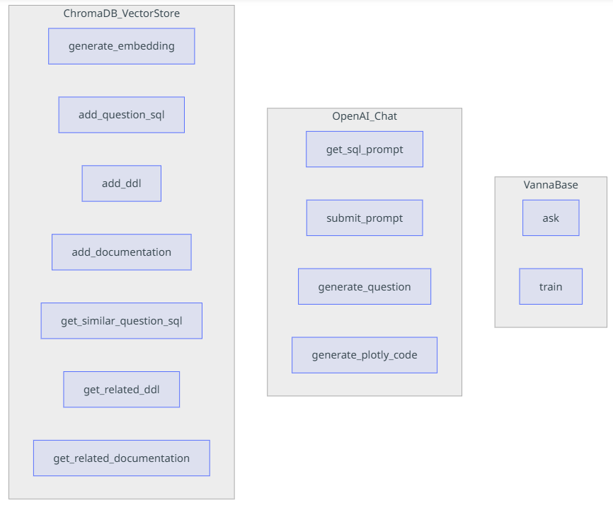
Other Important Functionalities
Generation of follow-up questions using vn.generate_followup_questions()
Automatically train the bot on a particular user query and SQL using auto_train=True
Allowing/disallowing LLM to see the database using allow_llm_to_see_data=True/False
Generation of prompt by providing list of questions and SQL queries using vn.get_sql_prompt()
Behaviour customization – All Vanna functions are inherited from the VannaBase class. All of these functions can be overridden to customize the results they provide.
List of all the functionalities –

Slide 7
Why Vanna ?
High accuracy on complex datasets.
Vanna’s capabilities are tied to the training data you give it.
More training data means better accuracy for large and complex datasets.
Secure and private.
Your database contents are never sent to the LLM or the vector database.
SQL execution happens in your local environment.
Supports any database and LLM.
The package allows you to connect to any SQL and vector database (refer supported list - https://github.com/vanna-ai/vanna?tab=readme-ov-file#supported-databases)
It also allows to connect to any LLM (refer supported list - https://github.com/vanna-ai/vanna?tab=readme-ov-file#supported-llms)
Choose your front end.
Most people start in a Jupyter Notebook.
Expose to your end users via Slackbot, web app, Streamlit app, or a custom front end.

Slide 8
Thank you

